Slide 1


Revolutionizing Diabetes Diagnosis: An Exploration of Machine Learning Models for Disease Prediction

Slide 2
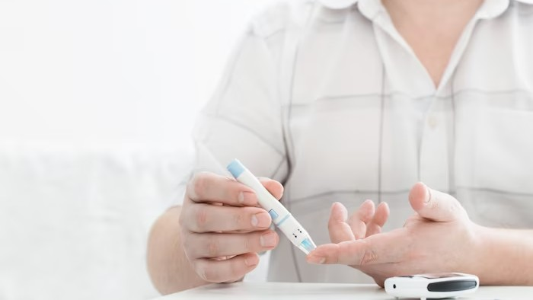
Introduction
Machine learning has emerged as a powerful tool in the healthcare industry, and its potential for diabetes prediction is no exception. One case study that highlights the effectiveness of machine learning models in predicting diabetes was conducted by researchers at the University of California, San Francisco.
The study used electronic health records (EHRs) to train a machine learning algorithm to predict the likelihood of a
patient developing diabetes. The algorithm was able to accurately predict the onset of diabetes up to six months in advance, giving healthcare providers ample time to intervene and prevent the disease from progressing. This study demonstrates the potential of machine learning models to improve the accuracy and efﬁciency of diabetes diagnosis, ultimately leading to better patient outcomes.

Slide 3

What is Diabetes?
Diabetes is a chronic disease that affects how your body turns food into energy. It is characterized by high levels of blood sugar. There are two main types of diabetes: Type 1 and Type 2

Slide 4

Current Diagnosis Methods
The current diagnosis methods for diabetes include fasting plasma glucose test, oral glucose tolerance test, and A1C test. However, these tests may not detect the disease early enough.

Slide 5

Machine Learning Models
Machine learning models have been used to predict diabetes from patient data. However, some of the existing models are inefﬁcient in this task.
Logistic Regression, Random Forest, and Support Vector Machines are some of the models that have been employed for this purpose.
To predict diabetes, machine learning models can analyze patient data using algorithms that detect patterns and make predictions. However, not all models are equally effective. Some of the models that are currently used for this task include Logistic Regression, Random Forest, and Support Vector Machines, GradientBoosting, XGBoost.

Slide 6

Data Collection
To train machine learning models, we need data. The data used for diabetes prediction includes patient demographics, medical history, and lifestyle factors. The more data we have, the more accurate the predictions.
We have collected the dataset from Kaggle.com

Slide 7
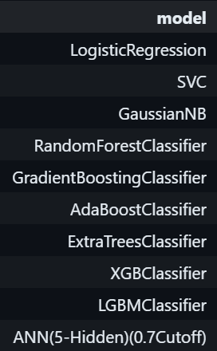

Existing Models
Machine learning models are essential in evaluating the accuracy of predictions. To do this, we rely on metrics such as accuracy, precision, and recall. These metrics allow us to assess how well the model is performing in predicting diabetes. With the help of machine learning models, we can make more informed decisions about patient care and treatment options. By analyzing the performance of these models, we can determine which ones are the most effective in predicting diabetes and develop more accurate
models in the future.

Slide 8

Proposed Model
A proposed artiﬁcial neural network (ANN) model for diabetes prediction has the potential to revolutionize the way diabetes is diagnosed and treated. By leveraging machine learning algorithms, the model can analyze large amounts of patient data to identify patterns and predict the likelihood of developing diabetes. This can help healthcare professionals to intervene earlier and provide personalized treatment plans, leading to better health outcomes for patients. Furthermore, the model can be continuously updated with new patient data, allowing for ongoing improvements in accuracy and effectiveness.

Slide 9
ANN Model Architecture
To build an Artiﬁcial Neural Network (ANN) model using TensorFlow Keras, the ﬁrst step is to import the necessary libraries. TensorFlow and Keras are the two main libraries that are required. After importing the libraries, the next step is to prepare the data. The data should be preprocessed and split into training and testing sets. The training set is used to train the model, while the testing set is used to evaluate the performance of the model.
It is important to note that building an ANN
model using TensorFlow Keras requires a good
understanding of machine learning concepts and
programming skills. It is also important to have a
clear understanding of the problem and
Once the data is prepared, the next step is to deﬁne the architecture of the model. This involves specifying the number of layers, the number of neurons in each layer, and the activation function for each layer. The number of layers and neurons in each layer can be adjusted based on the complexity of the problem. After deﬁning the architecture, the model is compiled with a loss function, optimizer, and metrics. Finally, the model is trained on the training set and evaluated on the testing set. The performance of the model can be improved by adjusting the hyperparameters and using techniques such as regularization and dropout.

Slide 10

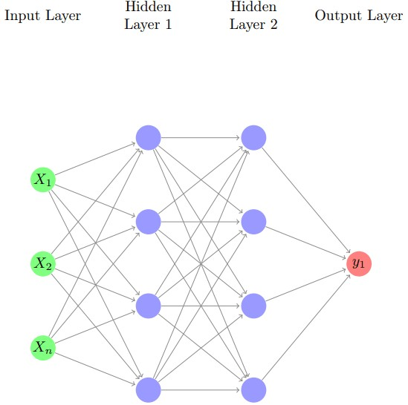
ANN Model Building

Slide 11

Model Metrices
The evaluation of machine learning models for diabetes prediction relies on several metrics such as accuracy, precision, recall, and f1 score. Accuracy represents the proportion of correct predictions made by the model, while precision measures the proportion of true positive predictions out of all positive predictions. Recall, on the other hand, represents the proportion of true positive predictions out of all actual positive cases. F1 score is the harmonic mean of precision and recall, providing a balanced measure of the model's performance.
These metrics are crucial in assessing the effectiveness of diabetes prediction models and improving patient care. With the continuous development of machine learning techniques, we can expect these metrics to improve and lead to even more accurate predictions in the future.

Slide 12
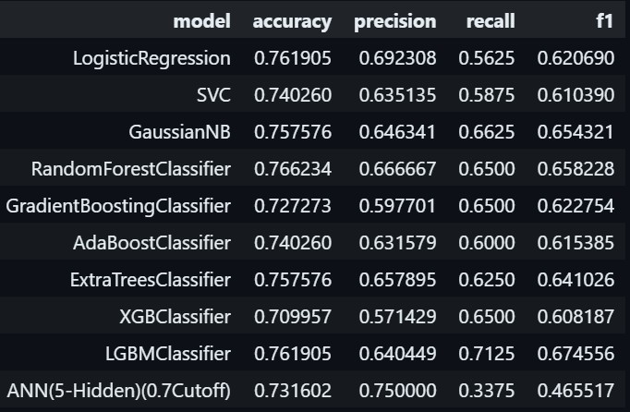
Model Metrices

Slide 13
Conclusion
Machine learning models have the potential to revolutionize diabetes diagnosis. They can detect the disease earlier, provide faster and less invasive diagnosis, and lead to better treatment outcomes.
In conclusion, the implementation of the Artificial Neural Network for diabetes prediction yielded promising results, highlighting its viability as a predictive tool. This study contributes to the ongoing efforts in leveraging machine learning techniques for healthcare applications, particularly in the early detection of chronic conditions like diabetes.

Slide 14
Thanks!
Do you have any questions?
aryachakraborty.ofﬁcial@g mail.com
+91-6290686301

